Slide 1
Search
Update a Cookbook to Dynamically Use Nodes with the Web Role

Slide 2
Objectives
After completing this module, you should be able to:
Describe the query syntax used in search
Build a search into your recipe code
Create a Ruby Array and Ruby Hash
Create load balancer cookbook that dynamically finds nodes with an assigned role
Notes:
In this module you will learn how to describe the query syntax used in search, build a search into your recipe code, create a ruby array and ruby hash, and create a new cookbook that can dynamically find nodes.

Slide 3

Our current Environment
Currently we have two webservers that we must browse to individually
Web Server
Workstation
Web Server
Notes:
Our current workstation has now bootstrapped two nodes and assigned them the web role. We can browse each web server with their public addresses and see the test page appear.

Slide 4

Introducing a Load Balancer
Adding a load balancer will allow us to better grow our infrastructure.
Receives requests and relays them to other systems.
Web Server
Workstation
Load Balancer
Web Server
Notes:
With two web servers running with our organization, it's now time to talk about the next goal to tackle. We need to setup a load balancer.
A load balancer is able to receive requests and relay them to other systems. In our case, we specifically want to use the load balancer to balance the entire traffic load between our two nodes.
This means we will need to establish a new node within our organization, install the necessary software to make the node a load balancer, and configure it so that it will relay requests to our existing web nodes (and any future web nodes).

Slide 5
Load Balancer
Work that needs to be accomplished to setup a load balancer within our infrastructure:
Write a load balancer cookbook.
Establish a new node within our organization to which we apply that cookbook.
Load Balancer Cookbook
Node to become load balancer
Chef Server
Notes:
Similar to how we installed and configured iis on our first node, we could do the same thing here with a load balancer. We could read documentation or find tutorials on how to implement IIS as a load balancer. They would likely have us install necessary applications, set the configuration for the applications, write out files, and start the service.
The powershell_script resource, template resource, registry_key resource, and service resource are the core of configuration management on Windows. Most every recipe you write will often use these fundamental resources. We could spend some time focused on composing the cookbook recipe and testing it on our platform with our custom configuration.

Slide 6
Load Balancer
Adding a load balancer will allow us to better grow our infrastructure.
Find or Create a Cookbook to Manage a load balancer
Configure the load balancer to send traffic to the web servers
Upload cookbook to Chef Server
Create 'load_balancer' role that includes the 'base' role
Bootstrap a new node (lb1) that runs the load balancer cookbook (via 'load_balancer' role)
Notes:
Let's find the iis-lb (load balancer) cookbook within the community site to learn more about it.

Slide 7
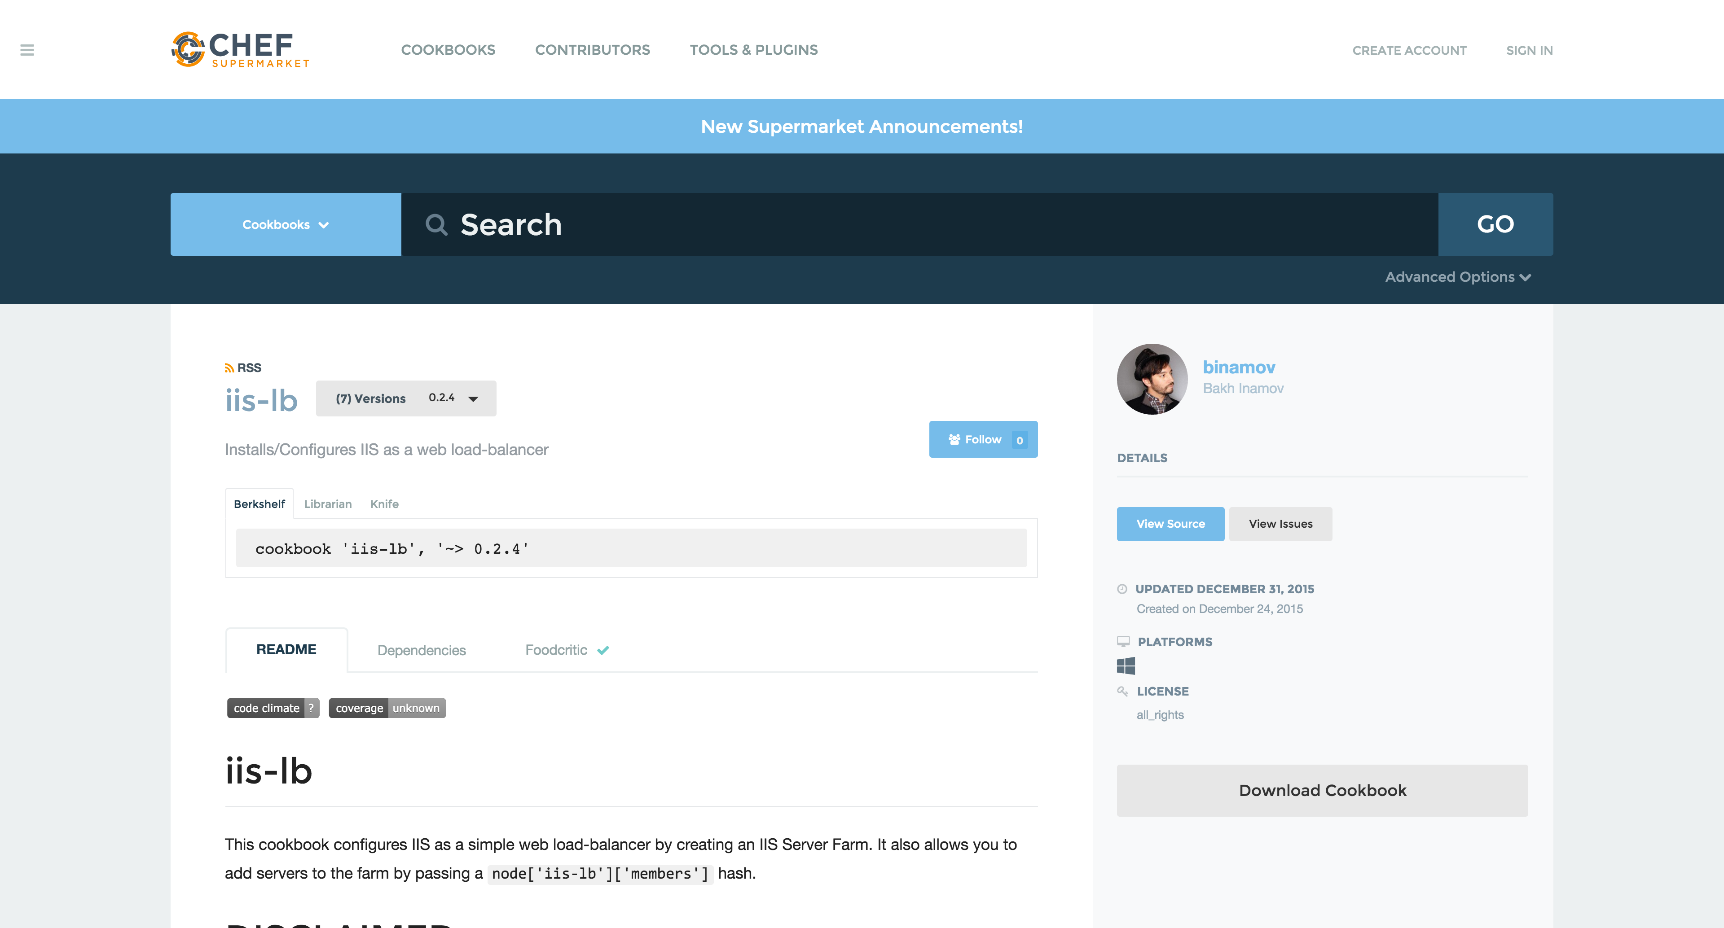
Supermarket Cookbooks
We will use the iis-lb community cookbook
Notes:
At this point you are presented with information that describes the cookbook. Starting on the right-hand side we see the individuals that maintain the cookbook, a link to view the source details, last updated date, supported platforms, licensing, and a link to download the cookbook.
On the left, we are presented with the various ways we can install the cookbook, the README that describes information about the cookbook, any cookbooks that this cookbook may depend on, a history of the changes, and its food critic rating--which is a code evaluator for best practices

Slide 8
Supermarket Cookbooks
Wrapper Cookbook
(New additional attributes)
We don’t want to change the community iis-lb cookbook, so we’ll wrap it in a myiis_lb cookbook
iis-lb
cookbook
(Attributes)
Notes:
A wrapper cookbook is a new cookbook that encapsulates the functionality of the original cookbook but allows us to define new default values for the recipes.
This is a common method for overriding cookbooks because it allows us to leave the original cookbook untouched. We simply provide new default values that we want and then include the recipes that we want to run.
Let's generate our wrapper cookbook named myiis_lb. Traditionally we would name the cookbook with a prefix of the name of our company and then follow it by the cookbook name 'company-cookbook'.

Slide 9
GL: Generate the Wrapper Cookbook
> cd ~\chef-repo
> chef generate cookbook cookbooks\myiis_lb
Generating cookbook myiis_lb
- Ensuring correct cookbook file content
- Committing cookbook files to git
- Ensuring delivery configuration
- Ensuring correct delivery build cookbook content
- Adding delivery configuration to feature branch
- Adding build cookbook to feature branch
- Merging delivery content feature branch to master
Your cookbook is ready. Type `cd cookbooks\myiis_lb` to enter it.
There are several commands you can run to get started locally developing and testing your cookbook.
Notes:
Change to your chef-repo directory and then generate your new cookbook.
Note: The name of the cookbook is 'myiis_lb', with an underscore in-between because the latest versions of Chef Development Kit do not allow you to use a dash.
Instructor Note: The generate cookbook command needs the path in the name of the cookbook here to ensure that it generates the cookbook in the cookbooks directory. Without it the cookbook will be generated within the root of the chef repository. If that happens simply have the learner move the newly generated cookbook into the cookbooks directory.

Slide 10
GL: Create a dependency and set version
~\chef-repo\cookbooks\myiis_lb\metadata.rb
name 'myiis_lb'
maintainer 'The Authors'
maintainer_email 'you@example.com'
license 'all_rights'
description 'Installs/Configures myiis_lb'
long_description 'Installs/Configures myiis_lb'
version '0.1.0'
depends 'iis-lb'
+
Notes:
Set up a dependency within your iis-lb cookbook. Establishing this dependency informs the Chef Server that whenever you deliver this cookbook to a node, you should also deliver with it the mentioned dependent cookbooks.
This is important because your cookbook is simply going to set up new default values and then execute the recipes defined in the original cookbook.

Slide 11
Demo: Edit the myiis_lb Default Recipe
~\chef-repo\cookbooks\myiis_lb\recipes\default.rb
#
# Cookbook Name:: myiis-lb
# Recipe:: default
#
# Copyright (c) 2018 The Authors, All Rights Reserved.
include_recipe 'iis-lb::default'
Notes:
Find the following example code within the README that the author has provided. This example code shows how to override the default values within a recipe. Copy and paste the example code into the default recipe above the include_recipe line.
More modifications are still necessary to override the original recipe and replace it with the values of the systems within our infrastructure.

Slide 12
Load Balancer
Adding a load balancer will allow us to better grow our infrastructure.
Find or create a cookbook to manage a load balancer
Configure the load balancer to send traffic to the web servers
Upload cookbook to Chef Server
Create 'load_balancer' role that includes the 'base' role
Bootstrap a new node (node3) that runs the load balancer cookbook (via 'load_balancer' role)
Notes:
Now that you have the dependency on the iis-lb cookbook in your wrapper cookbook, you need to learn what new default values you need to add to the recipe.

Slide 13
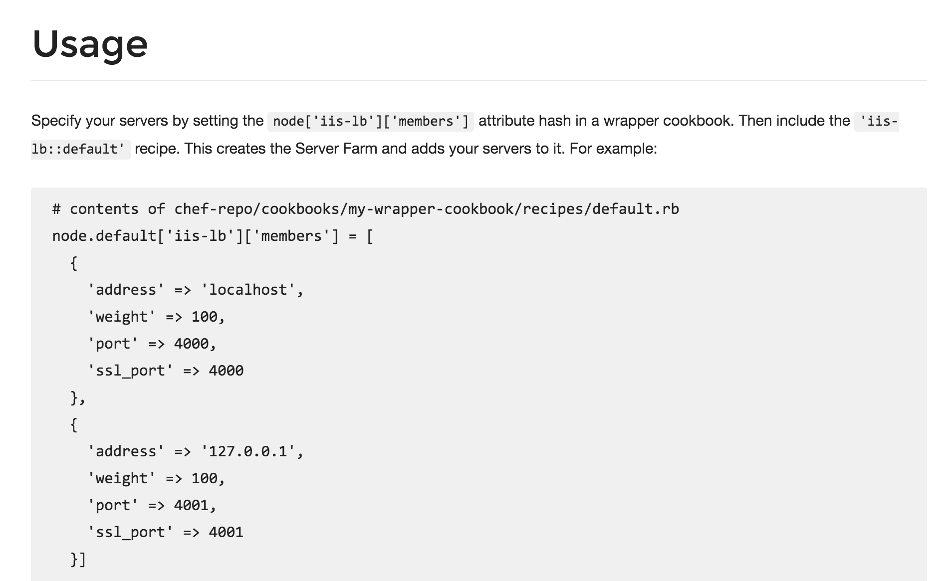
iis-lb Supermarket Cookbook
In the iis-lb cookbook, web servers in the load balancing pool are listed as attributes (iis-lb/attributes/default.rb)
The example in the cookbook's README.md illustrates how to overwrite these, but we need to add the IP Address or Hostname of our node1 and node2
https://docs.chef.io/supermarket.html#wrapper-cookbooks
Notes:
Currently the iis-lb cookbook assumes that there are two different services running on the localhost at port 4000 and port 4001. The iis-lb process will relay messages to itself to those two ports.
That is not our configuration. First, we currently only have one system that we want to route traffic. Second, we want to have the traffic routed not to localhost but instead to our webserver, node1, which will have a completely different hostname and IP address.
The area to focus most of your attention from the beginning is the README. The README describes the various attributes that are defined within the cookbook and the purpose of the recipe. This is the same README file found in the cookbooks we currently have within our organization. This one, however, has had far more details added to give new users like us the ability to understand more quickly what the cookbook does and how it does it.
Reading and understanding the README at a glance is difficult. It is a skill that comes with time. For the iis-lb cookbook, there is an defined attribute that establishes the members that receive the proxy requests from the load balancer. This is available in a node attribute available through `node['iis-lb']['members']`.

Slide 14
Demo: myiis_lb default Recipe Could Resemble This
~\chef-repo\cookbooks\myiis_lb\recipes\default.rb
node.default['iis-lb']['members'] = [
{
'address' => '34.196.63.231',
'weight' => 100,
'port' => 80,
'ssl_port' => 80
},
{
'address' => '34.196.104.17',
'weight' => 100,
'port' => 80,
'ssl_port' => 80
}]
include_recipe 'iis-lb::default'
Notes:
Add the second web server (node3) to the load balancer's (LB) members list. You may need to run 'knife node show node3 -a cloud' to get the hostname and ipaddress values.

Slide 15
Using Search
It seems inefficient to have to update a cookbook recipe each time we add another web server
To add new web servers to load balancing pool, we would need to bootstrap a new web server and then update our load balancer's myiis_lb cookbook recipe
We'll use search to update the load balancer automatically
Notes:
To add new servers as load balancer members, we would need to bootstrap a new web server and then update our myiis_lb cookbook to include that new web server. But that seems dramatically inefficient to have to update a cookbook recipe.
A more ideal solution would be for the recipe to instead discover all of the web servers within our organization and automatically add them list of available members for our load balancer.

Slide 16
The Chef Server and Search
Chef Server maintains a representation of all the nodes, roles, clients, etc. within our infrastructure. This information can be used to help our recipes discover other services within our organization.
node
node1
node2
role
web
...
Chef Server
https://docs.chef.io/chef_search.html
https://docs.chef.io/chef_search.html#search-indexes
Notes:
The Chef Server maintains a representation of all the nodes within an infrastructure and provides a way for us to discover these systems through Search.
Search is a service discovery tool that allows us to query the Chef Server across a few indexes. One such index is on our nodes.

Slide 17
The Chef Server and Search
We can ask the Chef Server to return all the nodes or a subset of nodes based on the query syntax that we provide it through knife search or within our recipes through search method.
node
node1
node2
role
web
...
Chef Server
Query
knife search command
search method
results
Find me all the nodes with the name node1
knife search node name:node1
search('node','name:node1')
node1
Find me all the nodes with the role web
knife search node role:web
search('node','role:web')
node1, node2
Notes:
We can ask the Chef Server to return back to us all the nodes or a subset of nodes based on the query syntax that we provide it through the knife command `knife search` or within our recipes through the `search` method.

Slide 18
Search Syntax
A search query is comprised of two parts: the key and the search pattern. A search query has the following syntax:
key:search_pattern
...where key is a field name that is found in the JSON description of an indexable object on the Chef server (node, role, environment, databag) and search_pattern defines what will be searched for
The search criteria "*:*" returns every node
Notes:
A search query is comprised of two parts: the key and the search pattern. A search query has the following syntax:
key:search_pattern
...where key is a field name that is found in the JSON description of an indexable object on the Chef server (a role, node, client, environment, or data bag) and search_pattern defines what will be searched for.

Slide 19
GL: View Information for All Nodes
> knife search node "*:*"
Node Name: node1
Environment: _default
FQDN: WIN-DCK5NTVVLBH
IP: 34.196.63.231
Run List: role[web]
Roles: web, base
Recipes: my_chef_client, my_chef_client::default, myiis, myiis::default, chef-client::default, chef-client::task, myiis::server
Platform: windows 6.3.9600
Tags:
Node Name: node2
Environment: _default
FQDN: WIN-DCK5NTVVLBH
IP: 34.196.104.17
Run List: role[web]
Roles: web, base
Recipes: my_chef_client, my_chef_client::default, myiis, myiis::default, chef-client::default, chef-client::task, myiis::server
Platform: windows 6.3.9600
Tags:
Notes:
So run the command knife search node "*:*” – you should see all nodes returned.
However, querying and returning every node is not exactly what we need to solve our current problem. In our scenario we want only to return a subset of our nodes (only the nodes that are webservers) and also we only want the IP address of those nodes, not any the other attributes returned.
Let's examine the search criteria more so we can understand how it works and how we can use it to find a subset of the nodes, and only the info we want for those nodes.

Slide 20
GL: Narrow the Search for all Web Nodes
> knife search node "role:web" -a cloud.public_hostname
node1:
cloud.public_hostname: ec2-34-196-63-231.compute-1.amazonaws.com
node2:
cloud.public_hostname: ec2-34-196-104-17.compute-1.amazonaws.com
Notes:
The ‘-a’ flag allows you to specify a particular attribute from those nodes. So if you append ‘-a ipaddress’ you’ll get the IP Address returned

Slide 21
Search Syntax within a Recipe
all_web_nodes = search('node','role:web')
Search the Chef Server for all nodes that have the role equal to 'web' and store the results into a local variable named 'all_web_nodes'.
Notes:
This example syntax could be translated to mean: Search the Chef Server for all node objects that have the role equal to 'web' and store the results into a local variable named 'all_web_nodes'.

Slide 22
Search Syntax within a Recipe
all_web_nodes = search('node','role:web')
creates and names a variable
the search criteria - key:value
assigns the value of the
operation on the right
into the variable on the left
the index or items to search
invokes the search method
Notes:
Search within a recipe is done through a `search` method that is available within the recipe.
The `search` method accepts two arguments. The first argument is a string or variable that contains the index or item to search on the Chef Server. These are: nodes; roles; and environments. The second argument is a string or variable that contains the search criteria to scope the results. This is using the notation 'key:value'.
The result of the search method is stored in a local variable that is named 'all_web_nodes'. Variables within Ruby are created immediately when you assign them.

Slide 23
GL: Edit the myiis_lb Default Recipe
~\chef-repo\cookbooks\myiis_lb\recipes\default.rb
all_web_nodes = search('node', 'role:web')
members = []
all_web_nodes.each do |web_node|
member = {
'address' => web_node['cloud']['public_hostname'],
'weight' => 100,
'port' => 80,
'ssl_port' => 80
}
members.push(member)
end
node.default['iis-lb']['members'] = members
include_recipe 'iis-lb::default'
Notes:
This is the complete recipe source code.
https://goo.gl/QoocpK

Slide 24
Load Balancer
Adding a load balancer will allow us to better grow our infrastructure.
Find or create a cookbook to manage a load balancer
Configure the load balancer to send traffic to the web servers
Upload cookbook to Chef Server
Create 'load_balancer' that includes the 'base' role
Bootstrap a new node (lb1) that runs the load balancer cookbook (via 'load_balancer' role)
Notes:
You have completed creating the wrapper cookbook. It is time to upload to the Chef Server.

Slide 25
Lab: Upload the Cookbook
Upload the cookbook to the Chef Server
Notes:
As a lab exercise, upload the cookbook to the Chef Server
Instructor Note: Allow 5 minutes to complete this exercise.

Slide 26
Lab: Install Cookbook Dependencies
> cd ~\chef-repo\cookbooks\myiis_lb
> berks install
Resolving cookbook dependencies...
Fetching 'myiis_lb' from source at .
Fetching cookbook index from https://supermarket.chef.io...
Using compat_resource (12.16.3)
Installing iis (5.0.5)
Installing iis-lb (0.2.4)
Using myiis_lb (0.1.0) from source at .
Using ohai (4.2.3)
Installing webpi (3.1.0)
Using windows (2.1.1)
Notes:
You change into the directory for the 'myiis_lb' cookbook.
We use the Berkshelf to upload our cookbooks. This is where Berkshelf really shines as a tool.
Run the command "berks install".
When you run this command for a cookbook that has a dependency, you'll see that Berkshelf will download the iis-lb cookbook and its dependencies as well. The iis-lb cookbook is dependent on the build-essential cookbook and the cpu cookbook. If any of those cookbooks had dependencies, berkshelf would find those and download them as well.
Instructor Note: Berkshelf downloads these cookbooks into a common directory within your home path. They are not added alongside your other cookbooks.

Slide 27
Lab: Upload the Cookbook to Chef Server
> berks upload
Skipping compat_resource (12.16.3) (frozen)
Uploaded iis (5.0.5) to: 'https://api.chef.io:443/organizations/awesomestudent'
Uploaded iis-lb (0.2.4) to: 'https://api.chef.io:443/organizations/awesomestudent'
Uploaded myiis_lb (0.1.0) to: 'https://api.chef.io:443/organizations/awesomestudent'
Skipping ohai (4.2.3) (frozen)
Uploaded webpi (3.1.0) to: 'https://api.chef.io:443/organizations/awesomestudent'
Skipping windows (2.1.1) (frozen)
Notes:
After installing all the necessary dependent cookbooks, we used 'berks upload' to send the cookbook and all its dependencies to the Chef Server. This is again an easier method to manage dependencies instead of manually identifying the dependencies and then uploading each single cookbook at a time.

Slide 28
Lab: Verify the Cookbook Upload
> knife cookbook list
chef-client 7.1.0
compat_resource 12.16.3
cron 3.0.0
iis 5.0.5
iis-lb 0.2.4
logrotate 2.1.0
my_chef_client 0.1.1
myiis 0.2.1
myiis_lb 0.1.0
ohai 4.2.3
webpi 3.1.0
windows 2.1.1
workstation 0.1.0
Notes:
When that is complete you can verify that you've uploaded your cookbook and all of its dependencies.

Slide 29
Lab: Upload the Cookbook
Upload the cookbook to the Chef Server
Notes:
As a lab exercise, upload the cookbook to the Chef Server
Instructor Note: Allow 5 minutes to complete this exercise.

Slide 30
Load Balancer
Adding a load balancer will allow us to better grow our infrastructure.
Find or create a cookbook to manage a load balancer
Configure the load balancer to send traffic to the web servers
Upload cookbook to Chef Server
Create 'load_balancer' role that includes the 'base' role
Bootstrap a new node (lb1) that runs the load balancer cookbook (via 'load_balancer' role)
Notes:
The new recipe has been created. Before assign it to a new node we should create a new role that will allow us to express this recipe and other requirements for our future load balancers.

Slide 31
GL: Create the Load Balancer Role
~\chef-repo\roles\load_balancer.rb
name 'load_balancer'
description 'Load Balancer'
run_list 'role[base]','recipe[myiis_lb]'
Notes:
Create a file named load_balancer.rb. This is a ruby file that contains specific methods that allow you to express details about the role. You'll see that the role has a name, a description, and run list.
The name of the role as a practice will share the name of the ruby file unless it cannot for some reason. The name of the role should clearly describe what it attempts accomplish. The description of the role helps reinforce or clarify the intended purpose of the role. When selecting a role name that is not clear it is important that a helpful description is provided to help ensure everyone on the team understands its purpose. The run list defines the list of recipes that give the role its purpose. Currently the load_balancer role defines a single recipe - the myiis_lb cookbook's default recipe.

Slide 32
GL: Upload the Role to the Chef Server
> cd ~\chef-repo
> knife role from file load_balancer.rb
Updated Role load_balancer
Notes:
Now you need to upload it to the Chef Server. This is done through the command 'knife role from file load_balancer.rb'.
The knife tool understands that you are uploading a role file and will look within the roles folder to find a file named knife role from file load_balancer.rb.

Slide 33
GL: Validate Chef Server Received It
> knife role list
base
load_balancer
web
Notes:
With the role uploaded, it is time to validate that the Chef Server received it correctly. We can do that by again asking the Chef Server for a list of all the roles on the system.

Slide 34
Load Balancer
Adding a load balancer will allow us to better grow our infrastructure.
Find or create a cookbook to manage a load balancer
Configure the load balancer to send traffic to the web servers
Upload cookbook to Chef Server
Create 'load_balancer' role that includes the 'base' role
Bootstrap a new node (lb1) that runs the load balancer cookbook (via 'load_balancer' role)
Notes:
The myiis_lb cookbook's default recipe is ready to be assigned to a run list of a node. So we'll need another node. The new load balancer node.

Slide 35
Lab: Bootstrap a New Node
> knife bootstrap windows winrm IP_OF_NODE3 -x USER -P PWD -N lb1
Creating new client for lb1
Creating new node for lb1
Waiting for remote response before bootstrap.34.196.106.169 .
34.196.106.169 Response received.
Remote node responded after 0.02 minutes.
Bootstrapping Chef on 34.196.106.169
34.196.106.169 Rendering "C:\Users\ADMINI~1\AppData\Local\Temp\bootstrap-3664-1485280632.bat" chunk 1
34.196.106.169 Rendering "C:\Users\ADMINI~1\AppData\Local\Temp\bootstrap-3664-1485280632.bat" chunk 2
34.196.106.169 Rendering "C:\Users\ADMINI~1\AppData\Local\Temp\bootstrap-3664-1485280632.bat" chunk 3
34.196.106.169 Rendering "C:\Users\ADMINI~1\AppData\Local\Temp\bootstrap-3664-1485280632.bat" chunk 4
34.196.106.169 Rendering "C:\Users\ADMINI~1\AppData\Local\Temp\bootstrap-3664-1485280632.bat" chunk 5
34.196.106.169 Rendering "C:\Users\ADMINI~1\AppData\Local\Temp\bootstrap-3664-1485280632.bat" chunk 6
34.196.106.169 Rendering "C:\Users\ADMINI~1\AppData\Local\Temp\bootstrap-3664-1485280632.bat" chunk 7
...
Notes:
Bootstrap a new node named node3 with the role of a load balancer in its run list.

Slide 36
Lab: Add a Recipe to a Run List
> knife node run_list set lb1 ”role[load_balancer]"
lb1:
run_list: role[load_balancer]
Notes:
lb1 does not have a list of recipes that it applies to the system by default. You can make Chef Server tell lb1 to apply a specific run-list the next time lb1 runs 'chef-client'.
You can do that through the 'knife node run_list set' command. In this example, you are setting lb1's run-list to the load_balancer role.

Slide 37
Lab: Validate the Run List
> knife node show lb1
Node Name: lb1
Environment: _default
FQDN: WIN-DCK5NTVVLBH
IP: 34.196.106.169
Run List: role[load_balancer]
Roles: load_balancer, base
Recipes: my_chef_client, my_chef_client::default, myiis_lb, myiis_lb::default, chef-client::default, chef-client::task, iis-lb::default, iis-lb::_arr, webpi::default, webpi::install-msi
Platform: windows 6.3.9600
Tags:
Notes:
When the converge is complete ensure the run list has been set correctly for node3.

Slide 38
Lab: Change the web server cache time
IIS Server has 60 second server side cache turned on by default.
To switch this off, RDP into lb1 (load balancer node) and:
Start menu > Administrative Tools >
Internet Information Services (IIS) Manager.
Expand your node on left side > Server Farms > myServerFarm
Double click 'caching', and set to '0’
Close & save

Slide 39
Point a web browser to the IP address of your load balancer node.
Refresh the page a few times to see the load balancer serve up each web server.
Please see notes below this slide.
Notes:
Instructor Note: IIS Server has 60 second server side cache turned on by default. To switch this off, RDP into lb1 (load balancer node) and
1. Start menu > Administrative Tools > Internet Information Services (IIS) Manager.
2. Expand your node on left side > Server Farms > myServerFarm
3. Double click 'caching', and set to '0'
4. Close & save
In the Environments section where we blow away the server farm, rerunning chef-client recreates the farm, so this would need to be reset

Slide 41
Discussion
What happens when new web nodes are added to the organization? Removed?
What happens if you were to terminate a web node instance without removing it from the Chef Server?
Notes:
Answer these questions.
With your answers, turn to another person and alternate asking each other asking these questions and sharing your answers.

Slide 42
Q&A
What questions can we help you answer?

